Slide 1

Introduction to AI & Workflow Automation
Notes:
Good evening everyone, and welcome! I'm Abirami and with me I have ” “, and today's session on AI and workflow automation comes in three parts. I'll be taking you through Part 1.
For the next 40 minutes, we're going to take AI apart. Open it up and see what's actually inside. After that, Part 2 looks at how automation is changing the way businesses work, and Part 3 is hands-on labs where you'll get to try things yourselves.

Slide 2
Part 1: What is AI
Understanding the core concepts, evolution, and current impact of Artificial Intelligence.
Notes:
Quick show of hands. Who has used ChatGPT, Gemini, Claude, or something similar this week?
[PAUSE]
Okay, almost everyone. Now keep your hand up if you could explain how AI actually works to an elderly person.
[PAUSE]
Perfect. That gap is exactly what we're closing today.
One more thing. Some of you have already built models, and some of you are completely new to this. Both are great. If I use a word you don't know, stop me. Seriously. If you're wondering about it, someone else in the room is too.

Slide 3


AI in Movies vs AI in Business
In the Movies
In Business
General: it can do anything.
Narrow: one job, done extremely well.
Has goals, feelings and a will of its own.
Driven by data, not desire.
Think JARVIS or the Terminator.
Fraud alerts, product recommendations, demand forecasts.
Notes:
Before we go any deeper, let's clear something up. A lot of what people think they know about AI actually comes from movies. [Point to the left card.] Think of JARVIS in Iron Man, or the robots in The Terminator. In movies, AI can do anything. It thinks for itself, it has feelings, and quite often it wants to take over the world.
[PAUSE]
[Point to the right card.] The AI that businesses actually use is very different. It's much more boring, and much more useful. It's the thing that flags a weird transaction on your card at 2am. It's the "you might also like" on Shopee. It's the model forecasting how much stock a warehouse needs next week. It does one job, and it does it really well.
[ASK] Turn to the person next to you. You have 30 seconds. Name one AI you used today without realising it was AI.
[Good ones: YouTube or Spotify recommendations, Grab arrival time, Face ID, spam filter, autocorrect.]
Great. Keep that picture in your head: narrow, practical, everywhere. That's the AI we're talking about today.

Slide 4

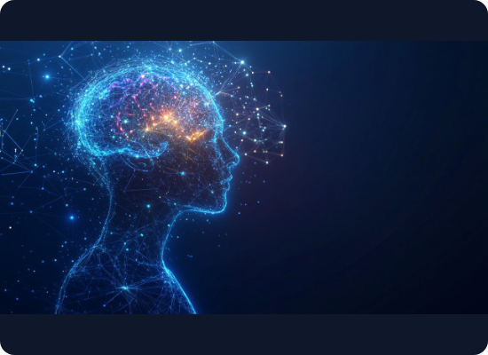
AI is a Loop, Not a Robot
→
Sense: Takes in data: text, images and audio.
→
Comprehend: Works out what that data means in context.
→
Act: Decides, generates or recommends.
→
Learn: Adjusts the model based on feedback, then the loop starts again.
Notes:
So if AI isn't a robot with feelings, what is it? Here's the simplest definition I know: AI is a system that runs a loop.
Sense. Comprehend. Act. Learn. And then back to Sense.
[PAUSE]
Let's make it human. You're crossing the road. You SENSE: you see a car, you hear a horn. You COMPREHEND: that car is fast, and it isn't stopping. You ACT: you step back onto the kerb. And you LEARN: next time at that junction, you look twice.
[PAUSE]
AI does those same four steps. It just uses data instead of eyes and ears, and it can do it millions of times a second.
The first two steps are about understanding the world. The last two are about doing something and getting better. Let's zoom into each half.

Slide 5
Inside the Loop
Sense & Comprehend
Act & Learn
Reads text, images and audio.
Decides, generates or recommends.
“This is sick!” Praise or complaint? Context decides.
Learns from every song you skip on Spotify.
Understands meaning, not just keywords.
A calculator never changes. AI does.
Notes:
First half: Sense and Comprehend.
Here's something that surprises people. Most of the data in the world is not neat rows in Excel. It's unstructured. Text: emails, reviews, PDFs. Vision: photos, scans, CCTV. Audio: calls, voice notes, meetings. For decades, computers were terrible at this. A spreadsheet? Easy. A photo of a cat? Basically impossible. Modern AI changed that. It can read a customer complaint and tell that the customer is angry. It can look at an X-ray and highlight something a doctor should check. It can listen to a call and transcribe it. That's SENSE.
COMPREHEND is the step beyond that: understanding context.
"This is sick!"
Is that a compliment or a complaint? Right, it depends. At a concert, it's a compliment. In a restaurant review, it's... not great. Understanding context is what separates AI from a simple keyword search. If you've heard of embeddings or attention, that's the machinery behind this. We won't go deep today, but that's where it lives.
Second half: Act and Learn.
ACT usually means one of three things. [Point to the right column.] Decide: approve this loan, flag this transaction. Generate: write the email, draft the code, create the image. Recommend: show this product next. And then the step that makes it AI and not just normal software: LEARN.
[PAUSE]
Every time you skip a song on Spotify, you're giving it feedback. The model adjusts. What it recommends to you tomorrow is a little different because of what you did today.
[ASK] Quick check. What's the difference between a calculator and Spotify's recommendation engine?
Exactly. Type 2 + 2 into a calculator and it says 4 today, tomorrow, and in ten years. An AI system gets updated by feedback.
Hold onto that idea, because that difference, between fixed rules and learning, is the whole story of the next 15 minutes.

Slide 6
The Evolution of AI
2000s: Machine Learning
2020s: Generative AI
Machines start learning patterns from data, not hand-written rules.
Foundation models (LLMs) don’t just classify. They create new text, code and images.
1980s: Rule-Based Systems
2010s: Deep Learning
Humans write every IF-THEN rule by hand. Rigid and hard to scale.
Many-layered neural networks master images and speech.
Notes:
So how did we get here? Let's time travel.
[Point to each stop as you go.]
The 1980s: Expert Systems. Researchers sat down with experts, like doctors and engineers, and wrote down everything they knew as rules. IF this, THEN that. Thousands of rules, all written by hand.
The 2000s: Machine Learning. Instead of following hand-written rules, algorithms started learning patterns from data. For example, predicting which customers might leave based on how they behaved in the past.
The 2010s: Deep Learning. Instead of writing rules, we fed computers huge amounts of data and let them work out the patterns themselves, using neural networks with many layers. This is when computers suddenly got good at recognising images and speech. A famous turning point was 2012, when a neural network called AlexNet won a big image-recognition competition by a huge margin, and the whole field shifted toward deep learning.
The 2020s: Generative AI. Models that don't just recognise things, they create things. ChatGPT launched at the end of November 2022 and became one of the fastest-growing apps ever.
[PAUSE]
Here's the pattern I want you to notice. Each era is really about who does the thinking. In the 1980s, humans write the logic. In the 2000s and 2010s, machines learn the logic. In the 2020s, machines learn the logic AND use it to produce something new.

Slide 7
Rules vs Learning: The Spam Filter Test
Rule-Based Filter (1980s)
Deep Learning Filter (2010s)
IF email says “FREE MONEY”, THEN spam.
Learns from a million labelled emails.
“FR33 M0NEY” slips straight past it.
Finds patterns nobody wrote down.
Every new trick needs a new hand-written rule.
Retrain it when spammers change tactics.
Notes:
Let's feel the difference with a real example.
This is a 1980s-style spam filter. IF the email contains "FREE MONEY", THEN it's spam. IF the sender is unknown AND there's a link, THEN it's spam.
Okay. You're a spammer. How do you beat this filter?
Exactly! You just broke a 1980s AI in about five seconds. And to fix it, a human has to write a new rule. And another one. And another one. That's why we call these systems brittle. They break the moment the world doesn't match the rules.
[Point to the right card.]
Now deep learning. You don't write any rules. You show the model a million emails, each one labelled "spam" or "not spam". It learns the patterns on its own, including ones no human would think to write down: strange sending times, odd formatting, suspicious link patterns. When spammers change tactics, you retrain it on new examples.
[PAUSE]
But to be fair, rules aren't dead. Rules are transparent, cheap, and predictable. If a bank says "any transfer above $10,000 needs a second approval", you want a clear rule, not a neural network making a guess.
So remember this: the real power is not rules OR learning. It's combining them. Keep that in mind, because it's exactly where Part 2 picks up.

Slide 8
The Generative AI Leap
→
Before: AI classified or predicted. A photo becomes “cat”, a transaction becomes “fraud”.
→
Now: AI generates. “Summarise this report” becomes a brand-new summary.
→
Foundation models: LLMs are trained to predict the next word. One model, thousands of uses.
→
Watch out: AI can hallucinate. Plausible isn’t the same as true, so keep a check in the loop.
Notes:
Now, the era you're living in.
[Point to “Before”.] Before the 2020s, almost all AI did this: classify or predict. Here's a photo: cat or dog? Here's a transaction: fraud or not? Here's last year's sales: what's next month? The output is a label or a number.
[Point to “Now”.] Generative AI does this: create. "Write me a product description." "Summarise this 40-page report." "Write Python to clean this dataset." The output is something that didn't exist before.
[PAUSE]
The engine behind this is called a foundation model. A Large Language Model, an LLM, is trained on an enormous amount of text: books, websites, code. And it's trained to do one deceptively simple thing: predict the next word.
That's it. But do that well enough, at a big enough scale, and you get something that can write essays, translate, answer questions, and write code.
We call it a "foundation" model because one model becomes the base for thousands of uses: customer service bots, coding assistants, writing tools. You don't build a separate model for every task anymore.
[ASK] Here's one to think about. If it's "just" predicting the next word, is it actually understanding anything?
Honestly, there's no agreed answer. Researchers still argue about this. But there's one practical consequence everyone agrees on. [Point to “Watch out”.] Because it generates what sounds plausible, it can confidently make things up. That's called a hallucination.
So in business, you always need a check: a human, or a rule, in the loop. That's the second idea I want you to hold onto. It'll come up again in Part 2.

Slide 9






Three Pillars of Modern AI
Machine Learning (ML)
Deep Learning
Generative AI
Finds patterns in historical data to make predictions. E.g. predicting which customers will cancel.
A subset of ML using many-layered neural networks for messy data. E.g. Face ID, speech-to-text.
A subset of deep learning that creates new content from a prompt. E.g. chatbots, image generators.
Notes:
Let's organise everything into three terms you'll hear constantly, and that people mix up all the time.
Machine Learning is the foundation. Systems that find patterns in historical data to make predictions. Classic example: predicting which customers are likely to cancel their subscription, based on how they behaved in the past. A lot of ML models are fairly simple. Some of you will use regression and decision trees in this club.
Deep Learning is a subset of ML. It's machine learning using neural networks with many layers. You need it for complex, messy data: faces, speech, medical scans.
Generative AI is a subset of Deep Learning. These are deep learning models that create new content from a prompt.
[PAUSE]
So: all generative AI is deep learning. All deep learning is machine learning. But not the other way round.
[ASK – quick-fire round. Read each one, and let the room call out the answer.]
"A model predicting house prices from size and location." [WAIT] Machine learning.
"Face ID unlocking your phone." [WAIT] Deep learning.
"An AI that designs a poster from a text description." [WAIT] Generative AI.
"Netflix predicting you'll like a show." [WAIT] Machine learning. [If someone says deep learning, that's fair too: big platforms often use deep learning for this.]
Nice. If you got those, you already understand this better than a lot of posts you'll see online.

Slide 10

The Current Landscape (2026)
AI is now the standard.
91%
91% of businesses use AI in at least one way, and the global AI market has passed $514 billion.
of businesses use AI
When 9 in 10 businesses do something, it stops being an advantage. It becomes the baseline.
Notes:
Here's where we are in 2026. 91% of businesses are using AI in some form. And the AI market is worth around 514 billion US dollars.
To put 514 billion in perspective: that's in the same ballpark as Singapore's entire economy for a year.
But I actually think the 91% is the more interesting number. [Point to it.] When nine out of ten businesses are doing something, it's no longer an advantage. It's the baseline.
So if almost everyone has AI... what do you think businesses are worried about now?

Slide 11
The Question Changed
Then: “Should we adopt AI?” Now: “How do we measure ROI and scale it?” Discuss in groups of three for 90 seconds.
Notes:
A few years ago, every boardroom was asking: "Should we adopt AI?"
Today, the question is: "How do we measure the return on investment, and how do we scale it?"
[ASK] Why do you think that shift happened? Get into groups of three with the people around you. You have 90 seconds.
Okay, let's hear it.

Slide 12
Why the Question Changed
→
Everyone has it: Using AI isn’t special anymore. Getting results from it is.
→
Pilots stalled: Many AI trials never got past the demo, so bosses want proof.
→
It costs real money: Computing power, licences, skilled people and data clean-up.
→
Scaling is hard: A demo takes an afternoon. Rolling AI out company-wide takes months.
→
Risk: Mistakes, privacy and regulation all need rules to scale safely.
Notes:
Here are the five big reasons.
One: everyone has it. Adoption isn't a differentiator anymore. Results are.
Two: lots of pilots never paid off. Many companies ran AI experiments that looked great in a demo and never made it into real use. Boards now want proof before they spend more.
Three: it costs real money. Computing power, licences, skilled people, and cleaning up data. The finance team wants to see a return.
Four: scaling is the hard part. A chatbot demo takes an afternoon. Plugging AI into a company's actual systems, data, and processes takes months.
Five: risk. Hallucinations, privacy, and regulations. To scale safely, you need rules and governance.
[PAUSE]
[ASK] If you were the data analyst, how would you actually measure whether an AI tool is worth it?
[time saved per task, error rates, cost per transaction, customer satisfaction, revenue change, always comparing before and after.]
And that's exactly why data analytics skills matter more now, not less. Someone has to measure whether the AI is paying off. That someone can be you.

Slide 13
Four Things to Remember
→
AI is a loop: Sense, comprehend, act, learn.
→
It evolved: From humans writing rules, to machines learning patterns, to machines creating content.
→
Three pillars: Machine learning, deep learning and generative AI, each one a subset of the last.
→
Business moved on: From “should we adopt AI?” to “is it paying off, and how do we scale it?”
Notes:
Let's lock it in.
AI is a loop: sense, comprehend, act, learn.
It evolved from humans writing rules, to machines learning patterns, to machines creating content.
Three pillars, nested inside each other: Machine Learning, Deep Learning, Generative AI.
And the business question has moved from "should we?" to "is it paying off, and how do we scale it?"
[PAUSE]
Remember the two things I asked you to hold onto: rules still matter, and generative AI needs checks. Put those together and you've got the perfect starting point for Part 2, The Automation Paradigm Shift. Thank you all, you've been a great group. I'll hand you over now.

Slide 14
Part 2: Workflow Automation
Moving from manual, repetitive tasks to seamless, automated execution.

Slide 15
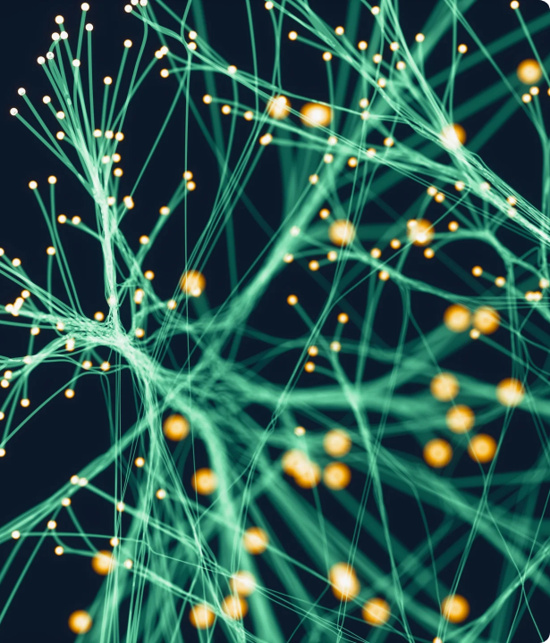
What is Workflow Automation?
Beyond Basic Task Execution
Workflow automation replaces manual processes with rule-based software logic.
It seamlessly routes data, triggers actions across disparate systems, and eliminates bottlenecks with minimal human intervention, ensuring operational consistency and speed.

Slide 16
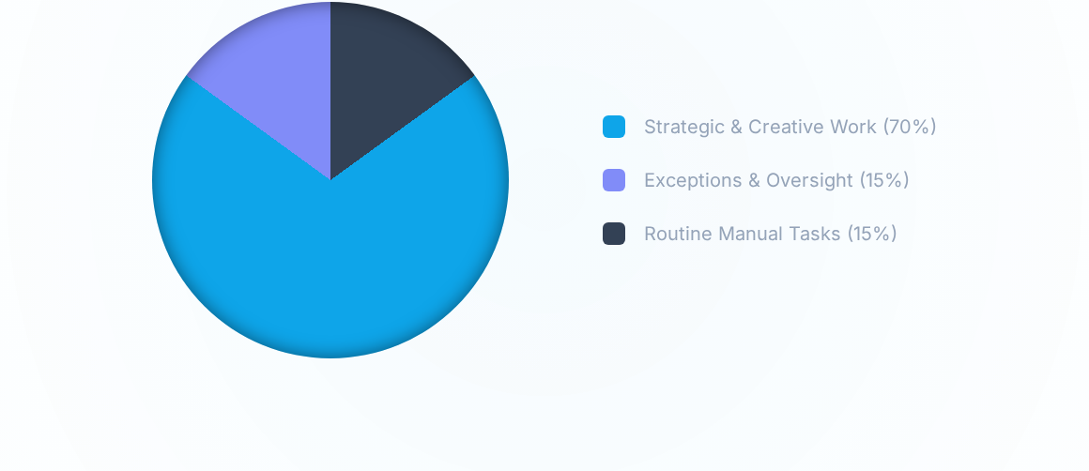
The ROI of Automation: Time Shift
By automating repetitive workflows, professionals (like marketers and developers) are saving an average of 6+ hours weekly, inverting the traditional time model to focus primarily on high-value, strategic work.

Slide 17
The Paradigm Shift: Intelligent Automation
Traditional Automation (RPA)
Intelligent Automation (AI + RPA)
Relies on strict, inflexible rules ("If this, then that").
Incorporates machine learning to adapt to exceptions and changing data.
Works only with highly structured data in predictable environments.
Can parse and process unstructured data (emails, PDFs, images) on the fly.
Breaks easily if the underlying application interface changes.
Continuously improves accuracy based on human-in-the-loop feedback.

Slide 18
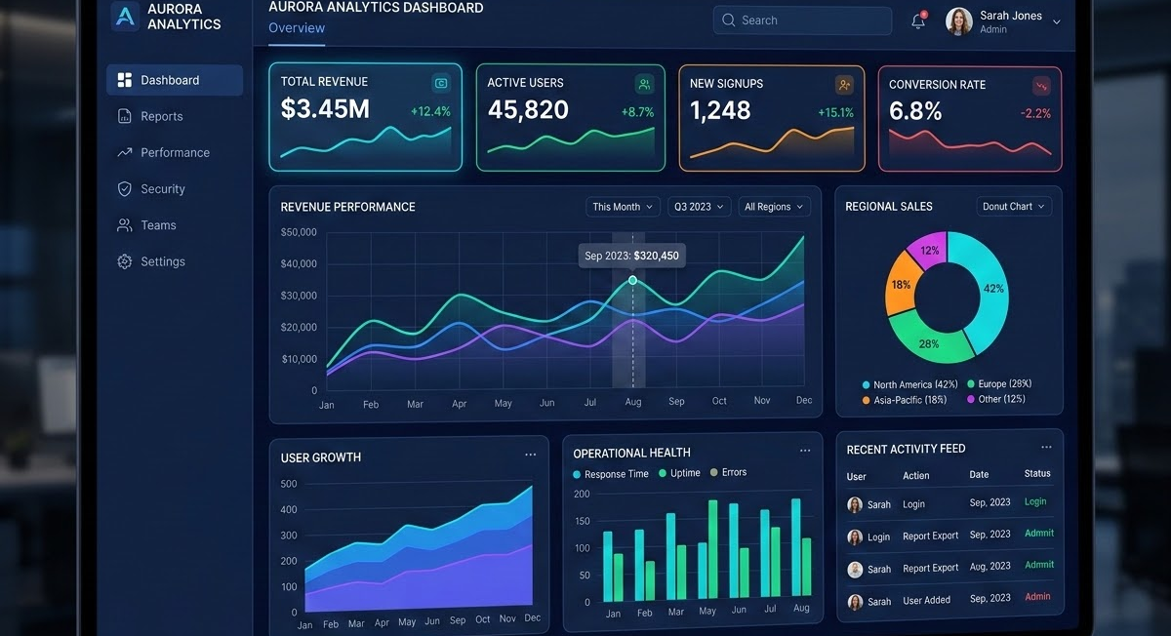




Real-World Enterprise Applications
Data Operations
Customer Success
HR Onboarding
AI automatically extracts key metrics from unstructured reports and populates dashboards instantly.
Intelligent routing categorizes support tickets by sentiment and drafts personalized initial responses.
Automated workflows provision software accounts, schedule meetings, and guide new hires dynamically.

Slide 19
Part 3: Interactive Labs
Transitioning from theory to practice with hands-on exercises.

Slide 20
Lab 1: AI in Action
Experiencing unstructured data extraction and synthesis.

Slide 21
Lab 2: Automating Workflows
Connecting applications to trigger intelligent actions.

Slide 22

Questions & Discussion
Thank you for attending Session 1.

